Slide 1



A Visual Analysis Of
TV Shows On
Online Streaming Services
OVERVIEW
TV
Shows
Online
Streaming
Services
5611
4
2
TV Show
Rating
Websites
Age
Groups
5
Spanning
9
Decades
Data Source: This has been downloaded from Kaggle. Below is the link to the data: https://www.kaggle.com/ruchi798/tv-shows-on-netflix-prime-video-hulu-and-disney
38%
90%
81%
of the TV Shows are streamed on Prime Video, followed by
Netflix at 34%, Hulu at 31% and the lowest, Disney+ at just 3%, probably as it is only 8 months old. Others are in business for more than 10 years.
of the TV Shows are released in or after 2000. and 75% of the TV Shows were streamed during or after 2010.
Only 0.19% are TV shows from before 1950.
Additionally, 18% of all TV Shows are targeted for 16+ audience.
is the average rating of the TV shows on Disney+ on Rotten Tomatoes, which is the highest. On IMDb, the highest average rating is 7.18% for Prime Videos, closely followed by Netflix at 7.16% and Hulu at 7%.
1

Slide 2

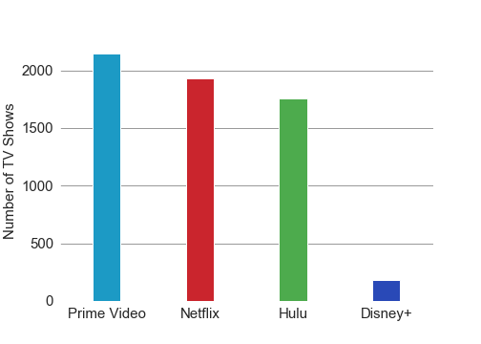
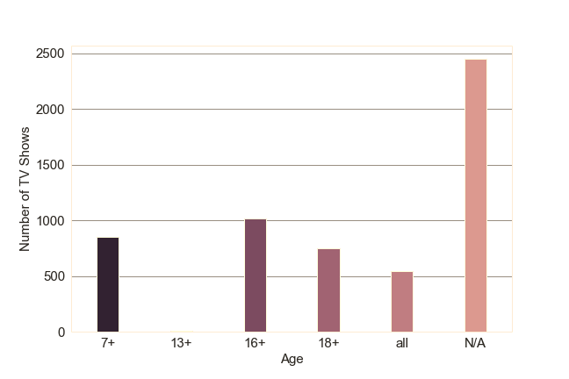
A Visual Analysis Of
TV Shows On
Online Streaming Services
Prime Video, Netflix and Hulu are way ahead of Disney+ in terms of number of TV Shows being streamed.
Data Source: This has been downloaded from Kaggle. Below is the link to the data: https://www.kaggle.com/ruchi798/tv-shows-on-netflix-prime-video-hulu-and-disney
Only 10% of the TV Shows are for family entertainment. 23% of the TV Shows whose target age group is known are for adults. Only 4 movies are targeted for the 13+ viewers.
2

Slide 3
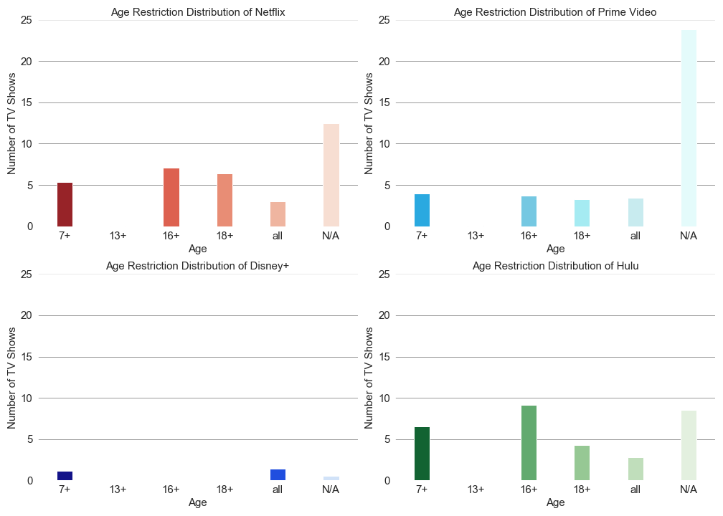
A Visual Analysis Of
TV Shows On
Online Streaming Services
Mostly 16+ and 18+ TV Shows
Uniformly distributed except for 13+ age group
Mostly TV Shows are suitable for all ages
Maximum percentage of 16+ TV Shows among all services
Data Source: This has been downloaded from Kaggle. Below is the link to the data: https://www.kaggle.com/ruchi798/tv-shows-on-netflix-prime-video-hulu-and-disney
3

Slide 4
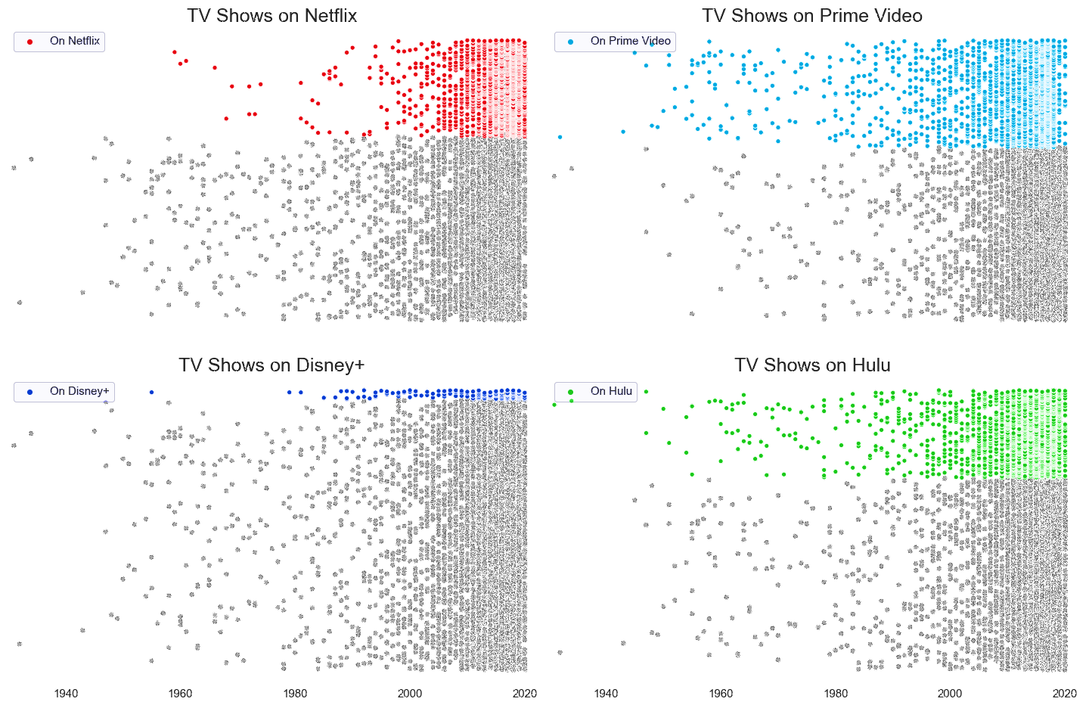
A Visual Analysis Of
TV Shows On
Online Streaming Services
Prime Video & Hulu have 5 and 3 times more TV Shows than Netflix from before 90s, respectively.
Hulu has the oldest show ‘Betty Boop, M.D.’ which was first aired in 1932.
Data Source: This has been downloaded from Kaggle. Below is the link to the data: https://www.kaggle.com/ruchi798/tv-shows-on-netflix-prime-video-hulu-and-disney
4

Slide 5
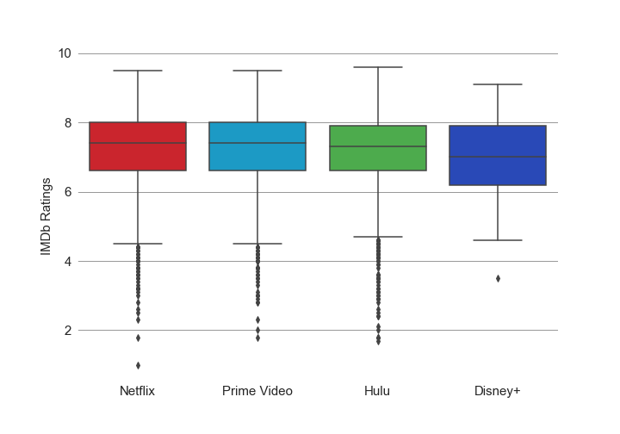
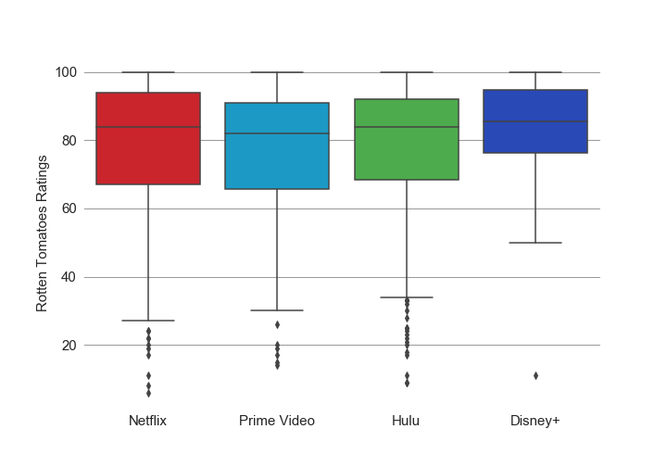
A Visual Analysis Of
TV Shows On
Online Streaming Services
The rating distributions of Netflix, Prime
Video and Hulu are almost same for
both IMDb and Rotten Tomatoes.
Data Source: This has been downloaded from Kaggle. Below is the link to the data: https://www.kaggle.com/ruchi798/tv-shows-on-netflix-prime-video-hulu-and-disney
Disney+ looks consistent on the quality of TV Shows
5

Slide 6
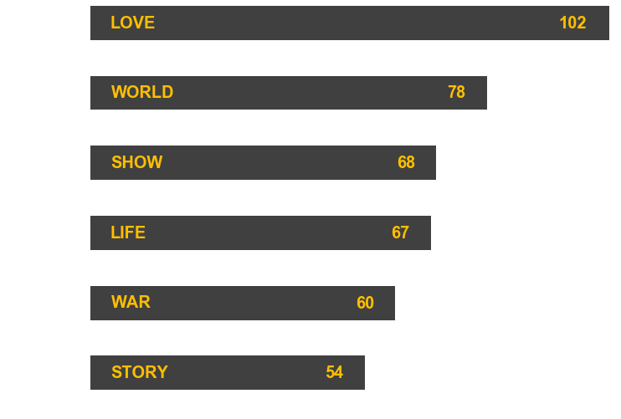

A Visual Analysis Of
TV Shows On
Online Streaming Services
Out of
5611
TV Show Titles
Data Source: This has been downloaded from Kaggle. Below is the link to the data: https://www.kaggle.com/ruchi798/tv-shows-on-netflix-prime-video-hulu-and-disney
5

Slide 7
A Visual Analysis Of
TV Shows On
Online Streaming Services
THANK YOU
5

